Slide 1
DriveShare
CIS 476: Term Project
Rayan Khalil

Slide 2
Live Demo
1

Slide 3
Design Explanation
2

Slide 4

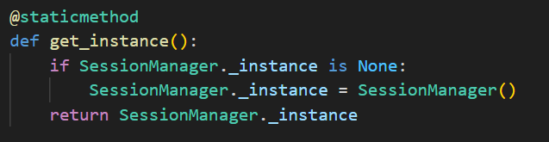
Pattern 1: Singleton
Ensures single instance of session to assist with user session management

Slide 5
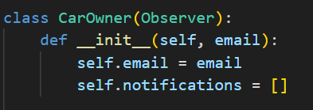
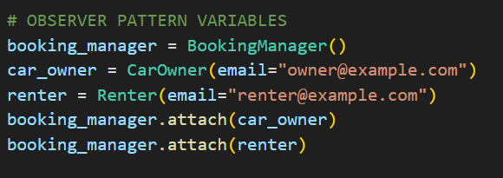
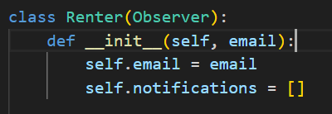
Pattern 2: Observer
Observers (Car Owner + Renter)
The main goal is to decouple the subject from the observers.
Observer Pattern in main application

Slide 6
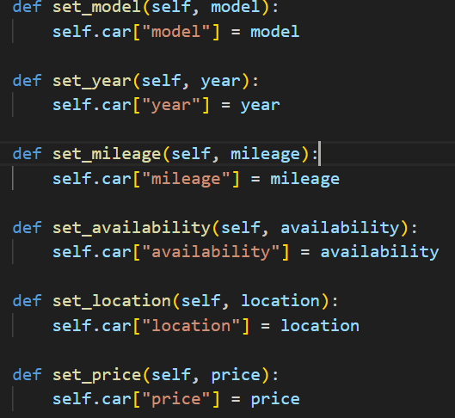
Pattern 3: Builder
Builder and Director
Sets various car related attributes
Separates construction logic from the car
Allows for more flexibility

Slide 7
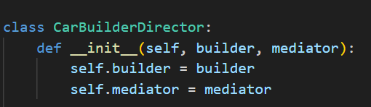
Pattern 4: Mediator
Mediator + Builder
Once the car is “built” and all attributes are set, the Car Builder notifies the Mediator
Mediator + Messages
Allows for smooth interaction/communication between UI components

Slide 8
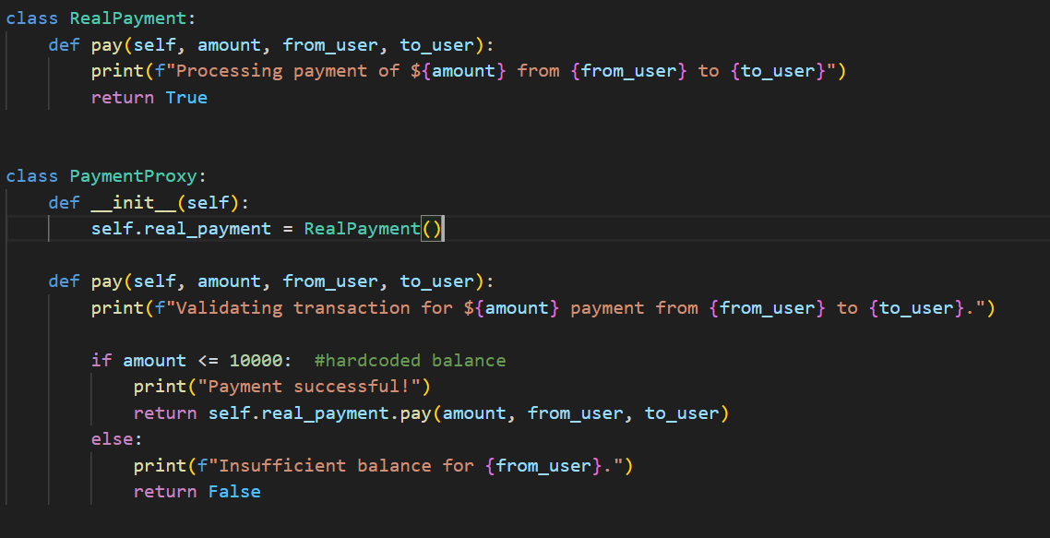
Pattern 5: Proxy
Assisted with validating the payment process
The PaymentProxy class has control over access to RealPayment

Slide 9
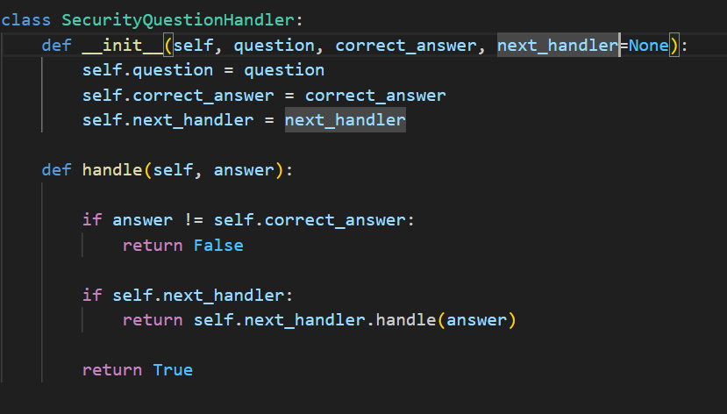
Pattern 6: Chain of Responsibility
Security Question Handler processes user’s input to security questions
Correct match? Move to the next handler
Moving down a chain

Slide 10
Thank You!

